Slide 1
Case Study Mining Algorithms with R
Milan A Joshi
Learner :- Data Science

Slide 2
Harvard Business Review
https://hbr.org/2012/10/data-scientist-the-sexiest-job-of-the-21st-century.

Slide 3
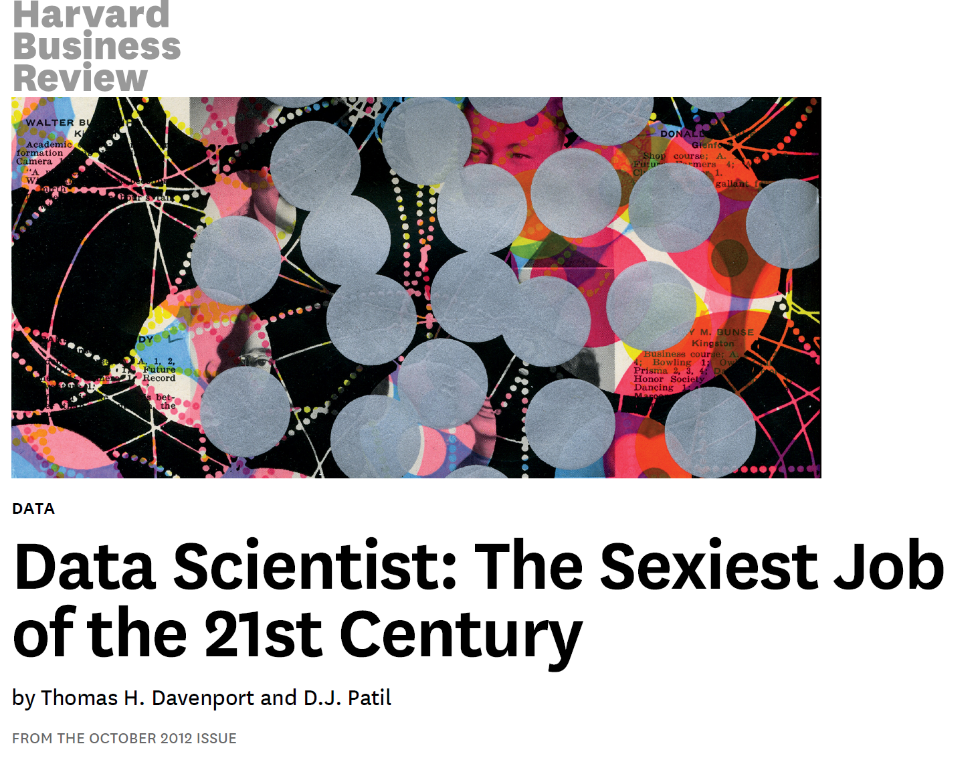

Slide 4
HBR
The shortage of data scientists is becoming a serious constraint in some sectors.

Slide 5
Mckinsey Report
http://www.mckinsey.com/business-functions/digital-mckinsey/our-insights/big-data-the-next-frontier-for-innovation
6. There will be a shortage of talent necessary for organizations to take advantage of big data. By 2018, the United States alone could face a shortage of 140,000 to 190,000 people with deep analytical skills as well as 1.5 million managers and analysts with the know-how to use the analysis of big data to make effective decisions.

Slide 6
Salaries….
http://economictimes.indiatimes.com/slideshows/work-career/11-hottest-job-profiles-that-will-only-scale-up-in-2015/slideshow/45532963.cms

Slide 7


Slide 8
Data Data Data….
Why so much data Possible.
Heavy Internet Penetration, Exposure to social Media, Cost of Internet, Cost of Memory and Storage Device has drastically gone down.
Data Getting Generated
Need People to analyze
The demand and rigour only going to increase

Slide 9
Learn BABY Learn
Data Scientists Never Die
They just get Broken Down By Age and Sex.
If you torture the data long Enough it will confess..
There are three kind of lies: Lies, Dammed Lies, and statistics.
An unlimited amount of computational resources is like Dynamite : If Used properly , it can move mountains. Used improperly, it can blow up your garage or your profile.

Slide 10
Motivation
Near about 207 models
43 classification Algorithms
10 regression Methods
7 Survival analysis
Caret dream Package in r for Predictive Modelling

Slide 11
Predictive Model
A mechanism that predicts a behaviour of an individual, such as click ,buy , lie or die(or prepay a mortgage).
It takes characteristics (Variables) of the individual as input and provide a predictive score as output.
The higher the score , the more likely it is that the individual will exhibit the predictive behaviour.

Slide 12
Predictive Modelling
Model Interpretability and Inferential Capacity are not Important.
Accuracy is what differs In Statistical Modelling and Predictive modelling .
In Predictive Modelling All we care about Accuracy.
How Models Generalizes well on unseen Data.
Difference between Memorizing the data and Learning From (Training) the data

Slide 13
Definitions and terminology
Examples: Items or instances of data used for learning or evaluation. In our spam problem, these examples correspond to the collection of email messages we will use for learning and testing.
Features: The set of attributes, often represented as a vector, associated to an example. In the case of email messages, some relevant features may include the length of the message, the name of the sender, various characteristics of the header, the presence of certain keywords in the body of the message, and so on.

Slide 14
Definitions and terminology
Labels: Values or categories assigned to examples. In classification problems, examples are assigned specific categories, for instance, the spam and non-spam
categories in our binary classification problem.
In regression, items are assigned real-valued labels.
Training sample: Examples used to train a learning algorithm. In our spam problem, the training sample consists of a set of email examples along with their
associated labels.

Slide 15
Definitions and terminology
Validation sample: Examples used to tune the parameters of a learning algorithm. when working with labeled data.
Learning algorithms typically have one or more free parameters, and the validation sample is used to select appropriate values for these model parameters.
Test sample: Examples used to evaluate the performance of a learning algorithm.

Slide 16
Definitions and terminology
The test sample is separate from the training and validation data and is not made available in the learning stage.
In the spam problem, the test sample consists of a collection of email examples for which the learning algorithm must predict labels based on features.
These predictions are then compared with the labels of the test sample to measure the performance of the algorithm

Slide 17
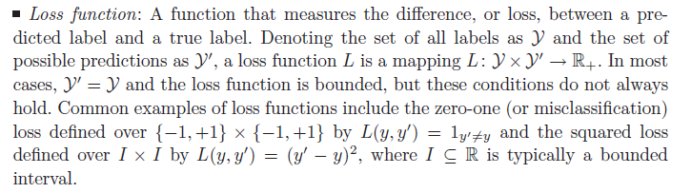
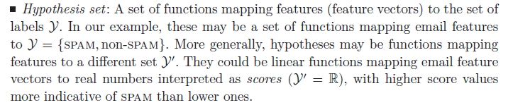
Loss Function/Hypothesis Set

Slide 18
Learning scenarios
Supervised learning: The learner receives a set of labeled examples as training data and makes predictions for all unseen points.
This is the most common scenario associated with classification, regression, and ranking problems.
The spam detection problem discussed in the previous section is an instance of supervised learning.

Slide 19
Learning scenarios
Unsupervised learning: The learner exclusively receives unlabeled training data, and makes predictions for all unseen points. Since in general no labeled example is available in that setting, it can be difficult to quantitatively evaluate the performance of a learner. Clustering and dimensionality reduction are example of unsupervised learning problems.

Slide 20
Learning scenarios
Semi-supervised learning: The learner receives a training sample consisting of both labeled and unlabeled data, and makes predictions for all unseen points.
Semi-supervised learning is common in settings where unlabeled data is easily accessible but labels are expensive to obtain.
Various types of problems arising in applications, including classification, regression, or ranking tasks, can be framed as instances of semi-supervised learning.

Slide 21
Learning scenarios
The hope is that the distribution of unlabeled data accessible to the learner can help him achieve a better performance than in the supervised setting.
The analysis of the conditions under which this can indeed be realized is the topic of much modern theoretical and applied machine learning research.

Slide 22
More Learning scenarios
Transductive inference
On-line learning
Reinforcement learning.
Active Learning

Slide 23
Training error /Testing Error
1 - Training
Training error is the error we get applying the model to the same data from which we trained.
2 - Test
Test error is the error that we incur on new data. The test error is actually how well we'll do on future data the model hasn't seen.

Slide 24
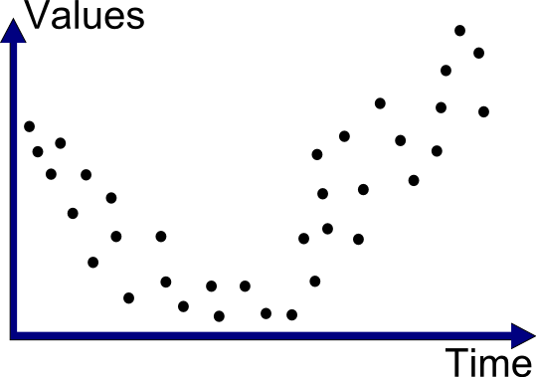
Forecasting model

Slide 25
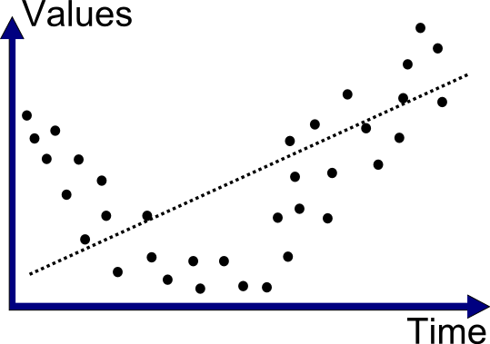
Linear model (error > 50%)
(numbers are made-up, just an illustration)

Slide 26
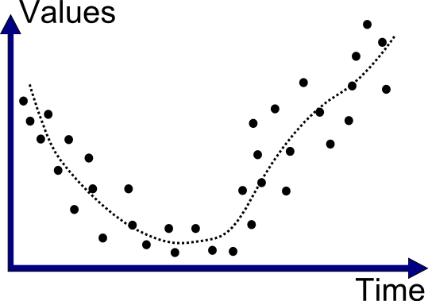
More complexity (error ≈ 10%)

Slide 27
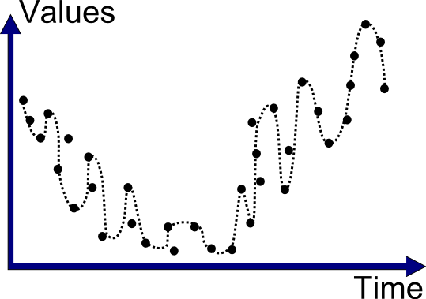
Too much complexity (error < 1%)

Slide 28
Comparing models
10% error
1% error
Model “fits”
Model “overfits”

Slide 29
Comparing models
10% empirical error
1% empirical error
Model “fits”
Model “overfits”

Slide 30
Comparing models
real error = ?
real error = ?
Model “fits”
Model “overfits”

Slide 31
Old school: bias vs. variance
high bias low variance
medium bias medium variance
low bias high variance

Slide 32
Bias-Variance Trade-off
Low Bias and Low variance.
Models that exhibit small variance and high bias underfit the truth target.
Models that exhibit high variance and low bias overfit the truth target
Thanks to vapnik.
http://insidebigdata.com/2014/10/22/ask-data-scientist-bias-vs-variance-tradeoff/

Slide 33
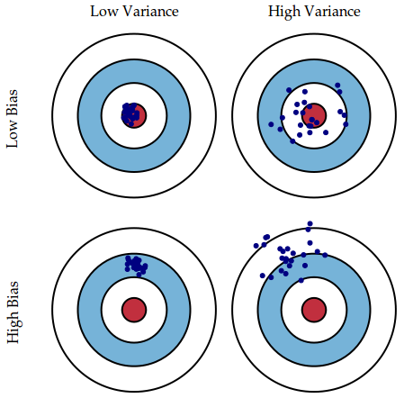
Bias/Variance

Slide 34
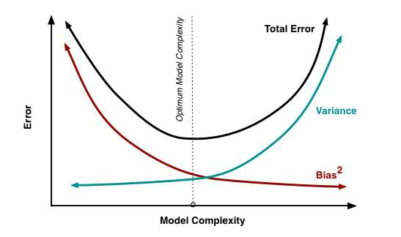
Bias-Variance Trade-off
We see that as the model complexity increases, the variance slowly increases and the squared bias decreases. This points to the trade off between bias and variance due to model complexity, i.e. models that are too complex tend to have high variance and low bias, while models that are too simple will tend to have high bias and low variance. The best model will have both low bias and low variance.

Slide 35
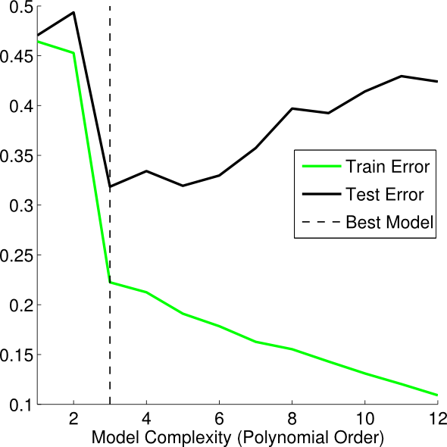
Best Model
Parameter tuning

Slide 36
Steps In Model Building
Understanding Problem. (Classification/ Estimation/ Clustering/Ranking/Dimension Reductions)
Knowing your data ( Dependent, Independent variables, (Response/Perdictor’s), Structure- Numeric ,Categorical(Levels), etc
Setting List of Hypothesis ( How things are related or associated )
Split in Train and Test (50-50% For this Problem70-30 is good)
Exploratory Analysis ( Summary(Min, Max, Avg, Sd, Quantiles,Missing Values),Outliers, Tables, Proportions, Association, Correlations, Plots(Bar chart, Box Plot, Mosaic Plots, Scatter Matrix Plots.

Slide 37
Steps in Model Building
Missing Value Treatment(mlr:- Imputation)
Feature Selection( Relevant Features, Boruta)
Building Model ( Logistic Regression, Decision Tress, Random Forest, Naïve Baye’s, SVM(Linear/Radial))
Logistic Regression Parametric and rest Models are Non Parametric
Testing Performance( Confusion Matrix, ROC and Area Under ROC)(Training/Testing)
Improving Performance( Pruning, Cross-validation, Removing Variables)
Presenting results

Slide 38

What I Used and Why!!!

Slide 39
Why R
47% Market Shares.
Over 2 Million Developers.
Any Competition on Kaggle
Any Research
Teaching
Coursera
Revolutionary Analytics own by Microsoft

Slide 40
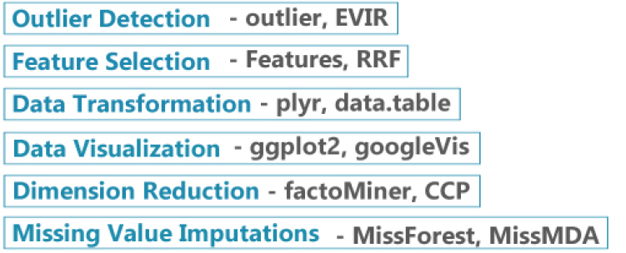
Tools in R

Slide 41
R packages
Knitr performanceAnalytics
Caret klaR
AppliedPredctiveModeling
pastecs
ggplot2
vcd
VIM
mlr
Boruta
rpart
rpart.plot
pROC
randomForest
e1071

Slide 42
Problem
A super market is offering a new line of organic products. The supermarket’s management wants to determine which customers are likely to purchase these products.
The supermarket has a customer loyalty program. As an initial buyer incentive plan, the supermarket provided coupons for the organic products to all of the loyalty program participants and collected data that includes whether these customers purchased any of the organic products.
The ORGANIC dataset contains 13 variables and over 22000 observations.

Slide 43
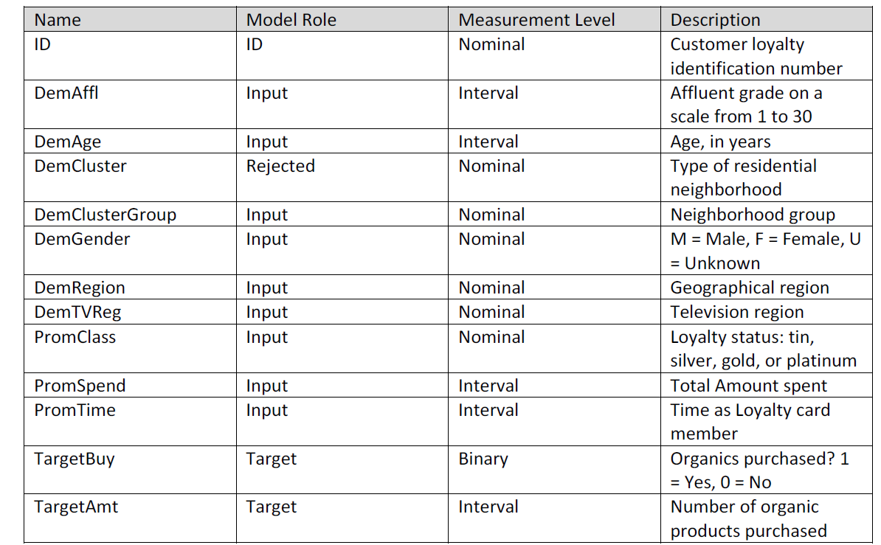
Variables
Overlap Measure for TargetBuy

Slide 44
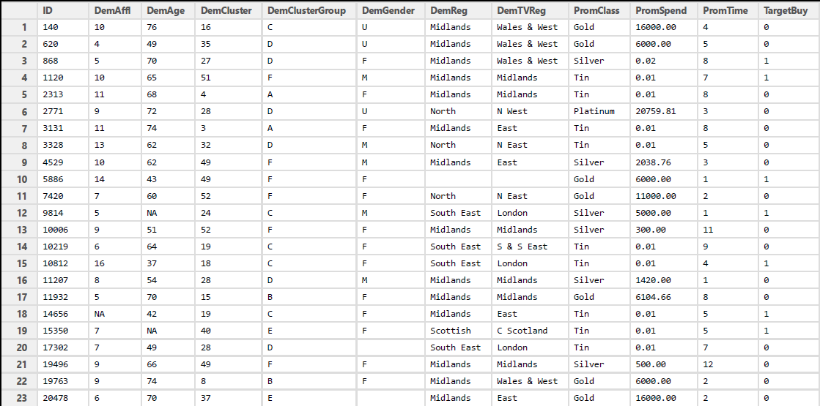
Partial-R-DataSet
Response

Slide 45
Spliting DataSet
Used Caret R package to create Partition of data in Training and Test set
50% Train 50% Test
Understand Structure of train data

Slide 46
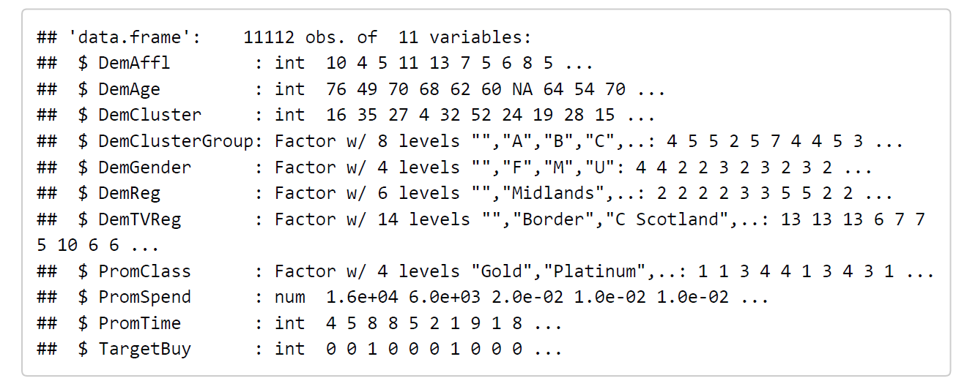
Structure of train data
Convert to Factor

Slide 47
Structure
$ DemGender : Factor w/ 4 levels "","F","M","U": 4 4 2 2 4 2 3 2 2 3 ...
blanks
12 Variables
6 Numeric
5 character

Slide 48
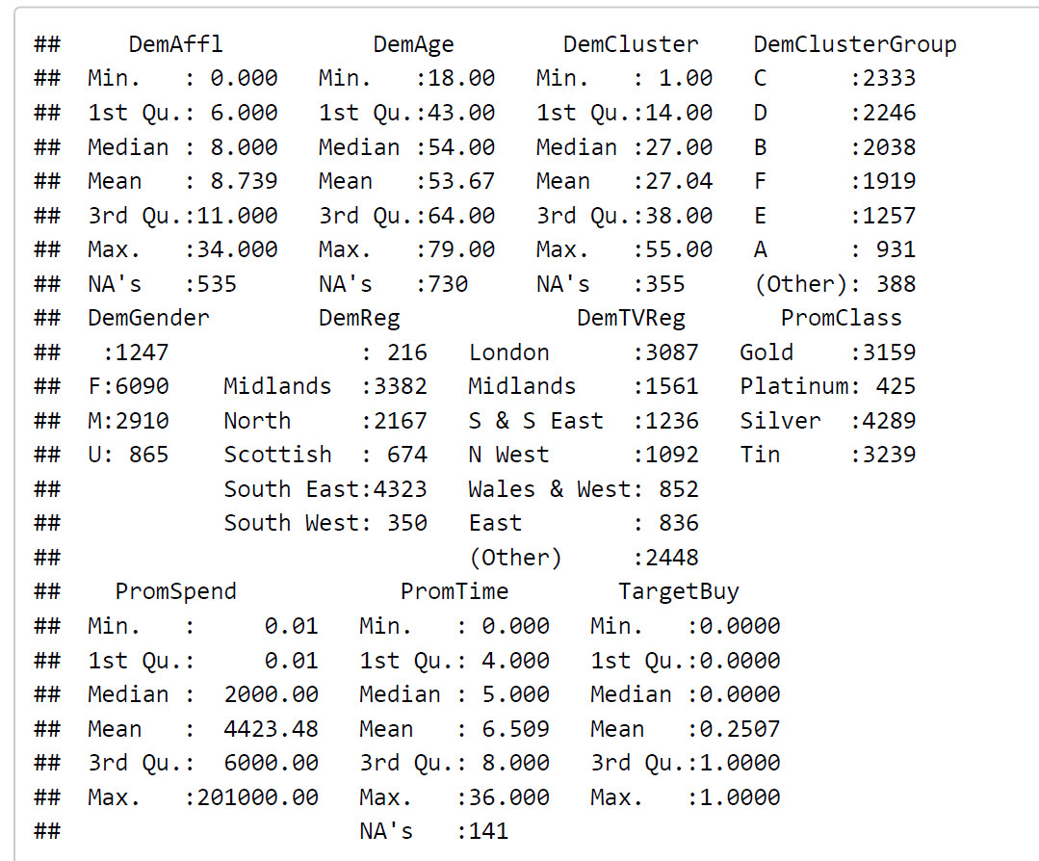
Summary Statistics train data

Slide 49
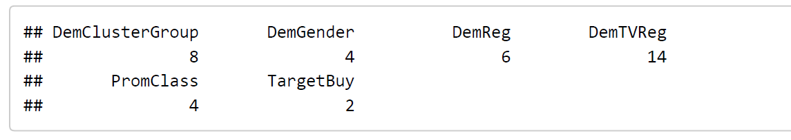
Checking Levels of each categorial variables
Converted to factor

Slide 50
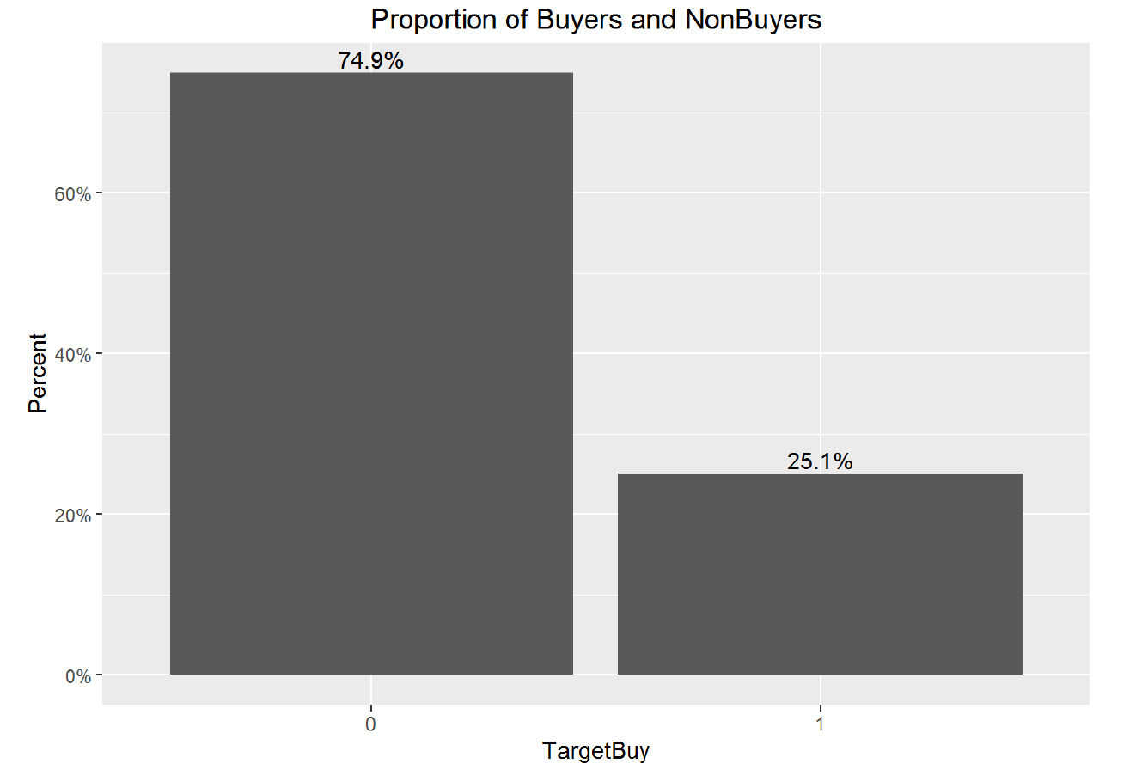
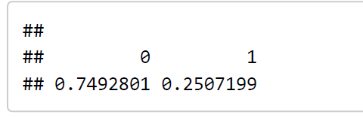
Proportion TargetBuy

Slide 51
Step1:- Cleaning the data
Variable(Numeric) | Missing Values(NA)
DemAffl | 1085
DemAge | 1508
DemCluster | 674
PromTime | 281
Variable (character) | Blank Values(“ ”)
DemGender | 2144
DemReg | 394

Slide 52
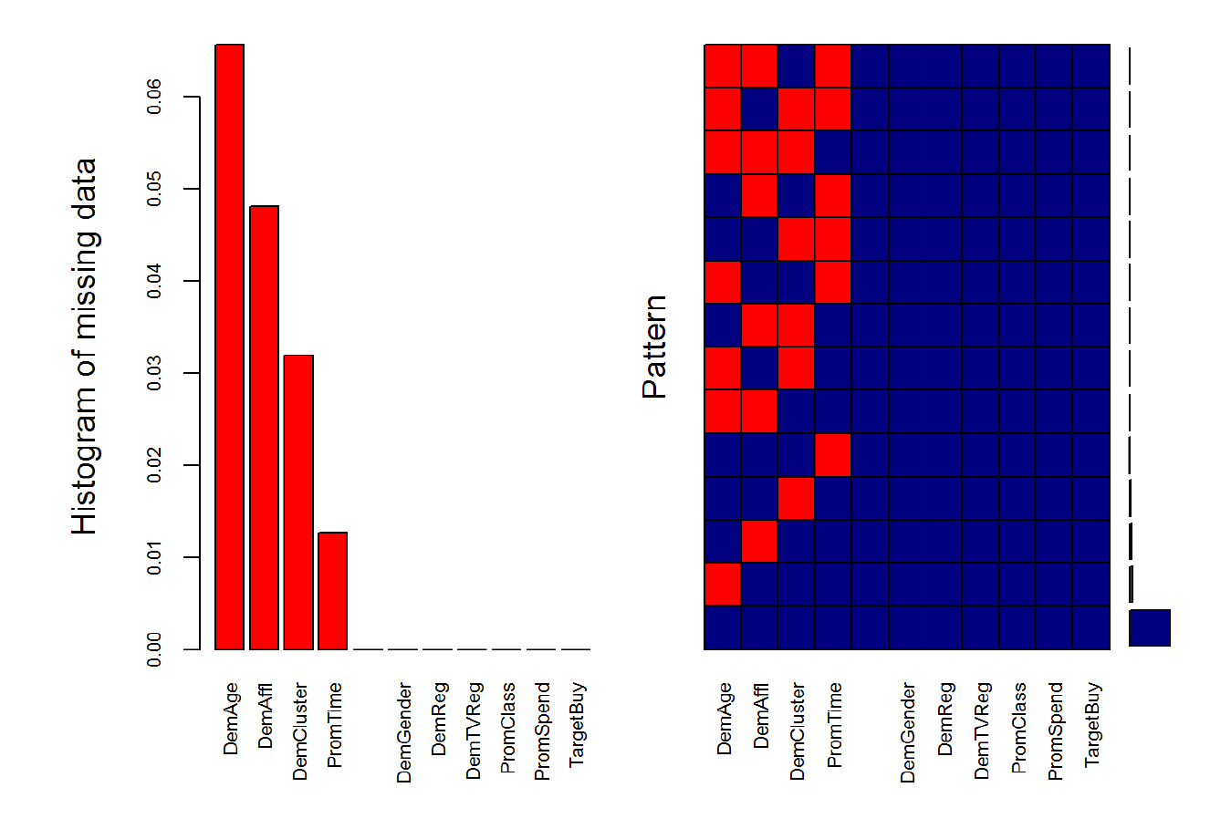
Missing Value Pattern(VIM)

Slide 53
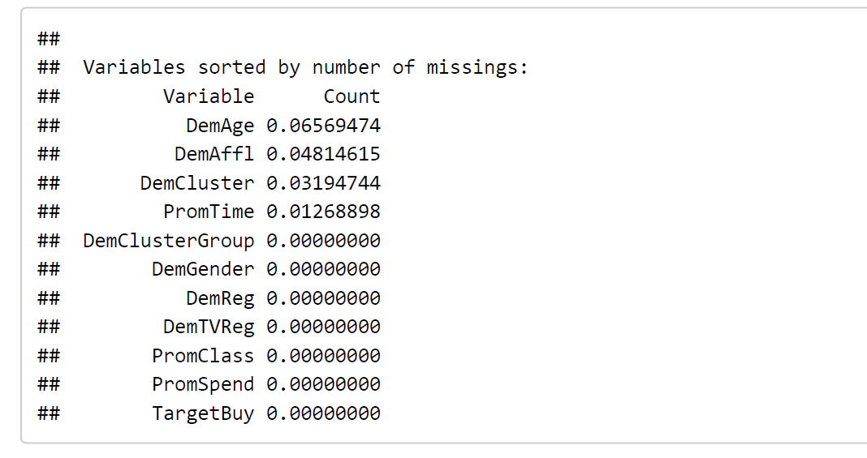
Count for Missing Values

Slide 54
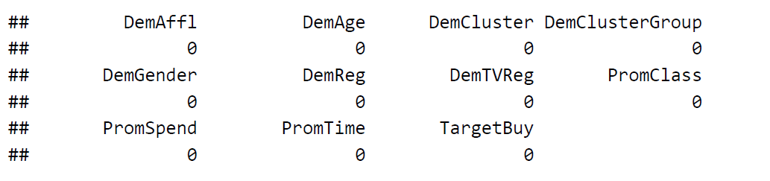
Imputation Missing values(mlr)
Using Mode and Mean Imputation for Both train and test set

Slide 55
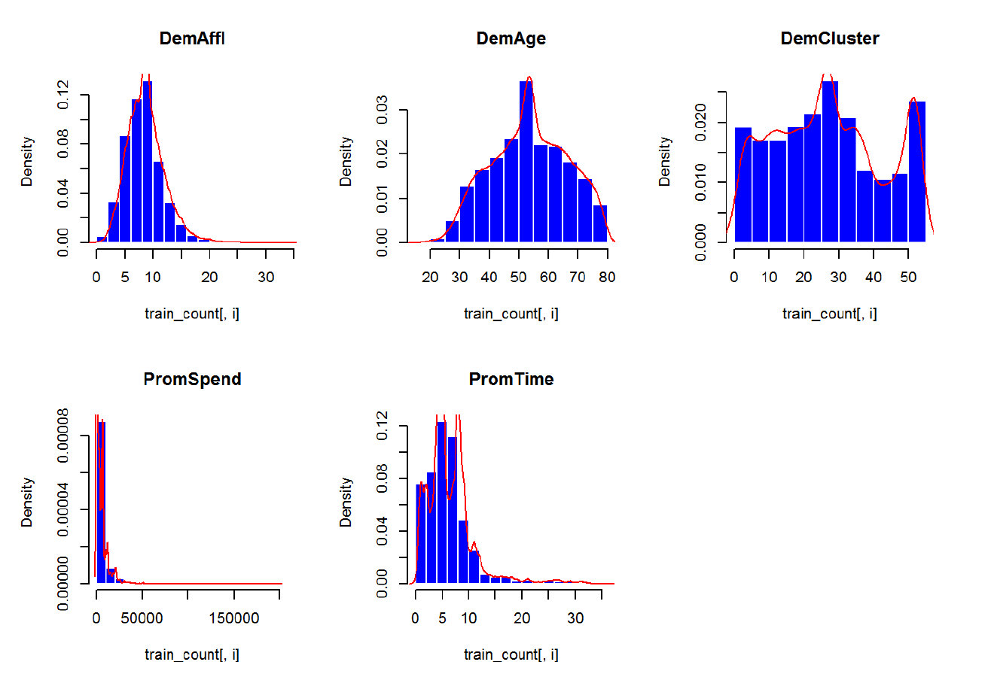
Distribution of Numerical variables train data
Skewed

Slide 56
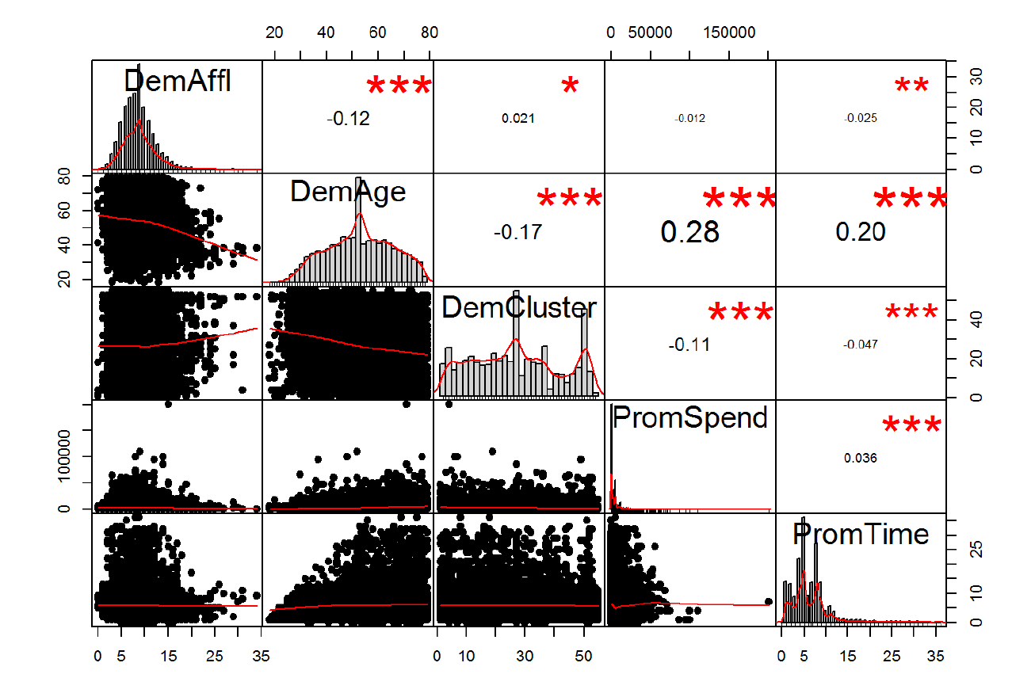
Correlations between Numeric variables(performanceAnalytics)

Slide 57
To worry About distributions
Most of Model are Nonparametric
Don’t care about distribution too much
Only logistic Regression is parametric
TargetBuy is binomially distributed

Slide 58
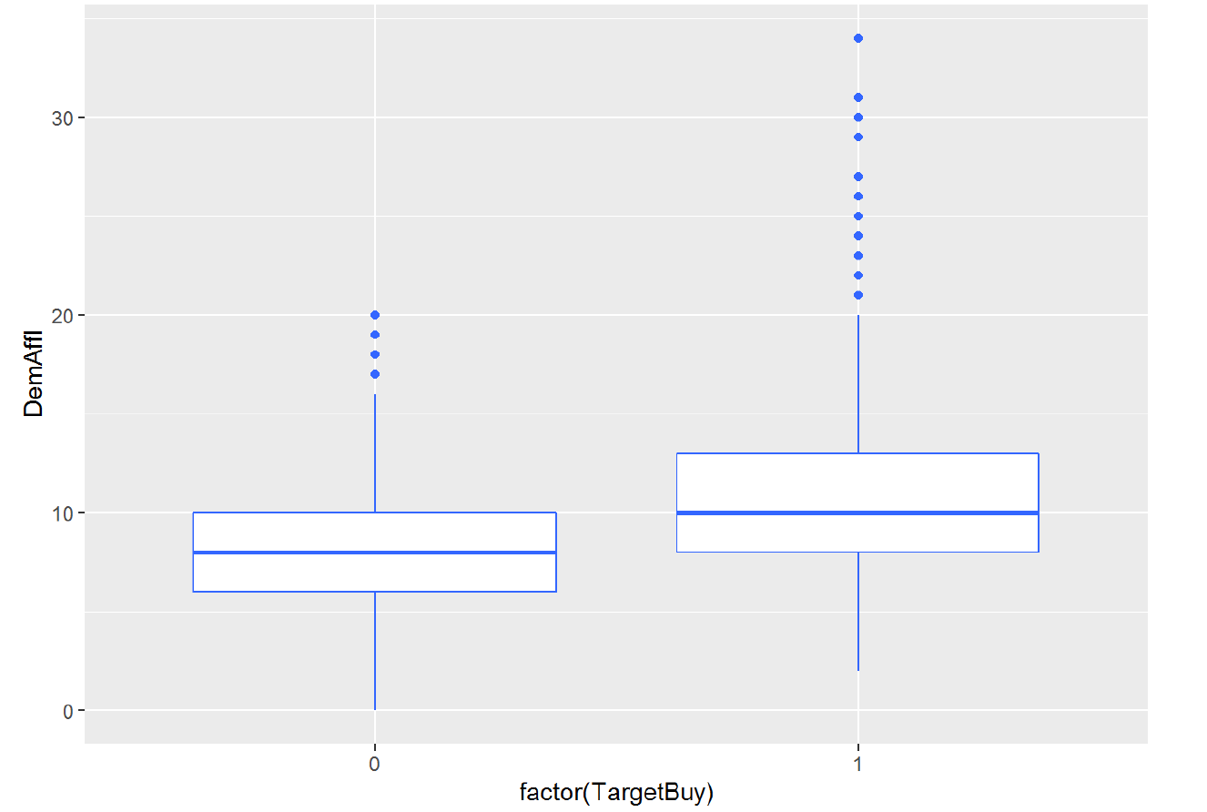
Box plot TargetBuy and DemAffl
No Buyers
All Buyers

Slide 59
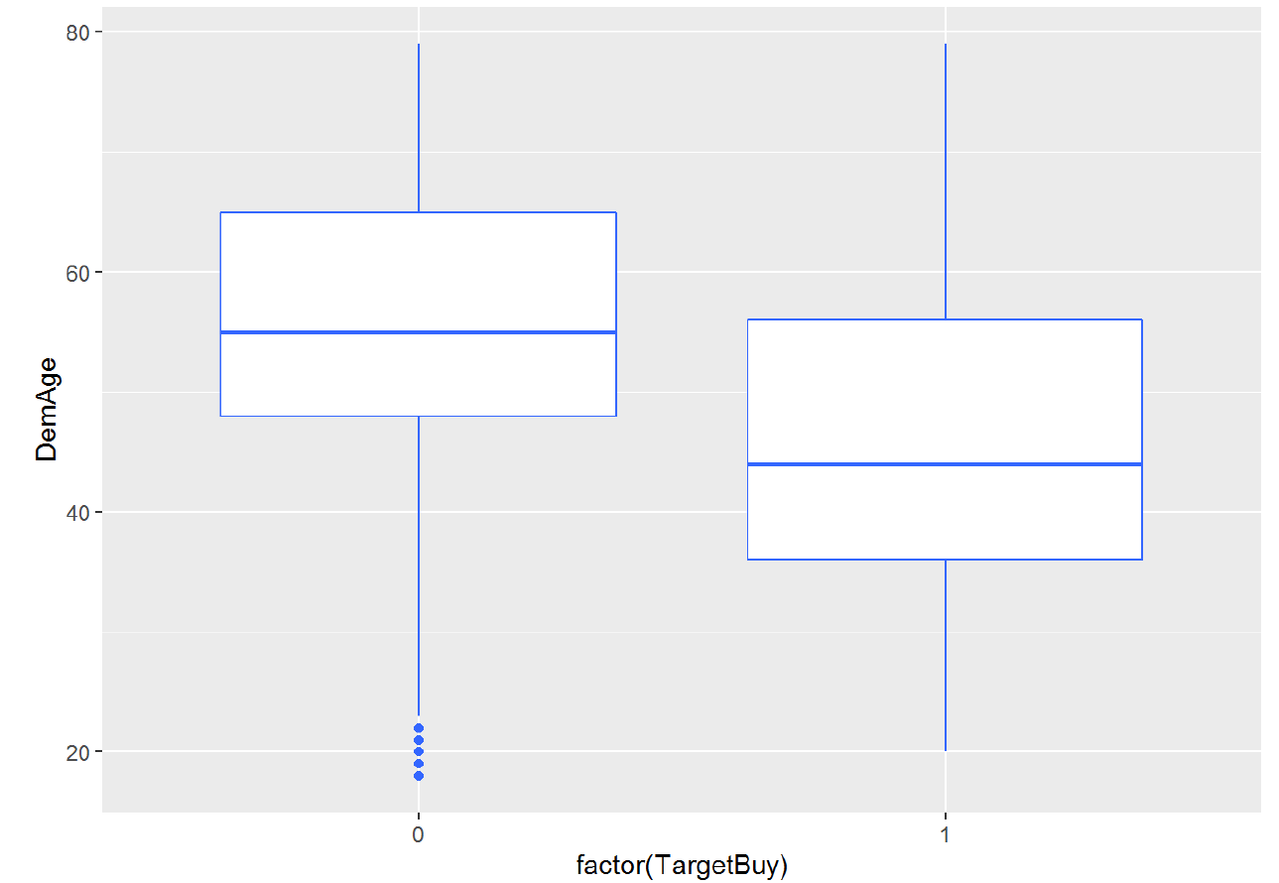
Boxplot DemAge and TargetBuy

Slide 60
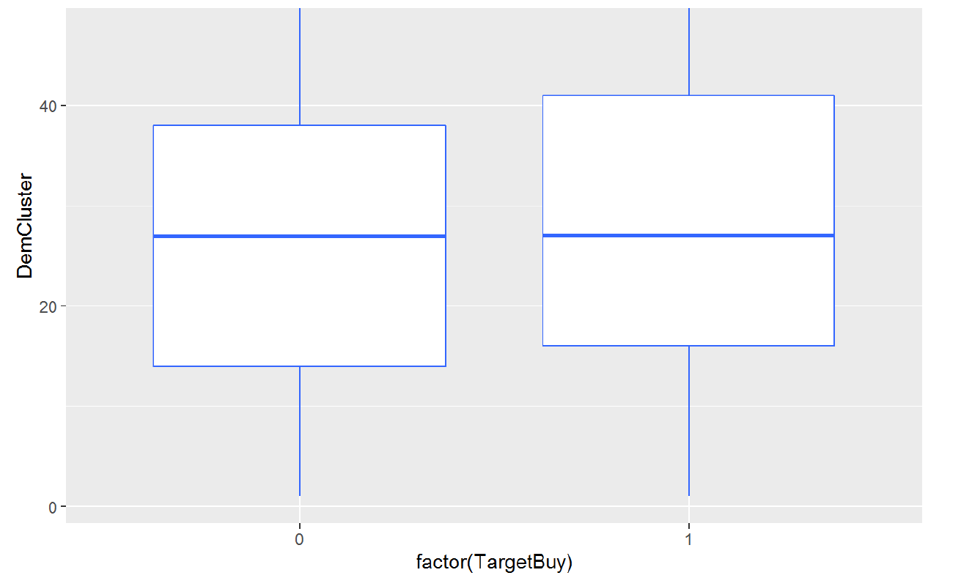
DemCluster and Target Buy

Slide 61
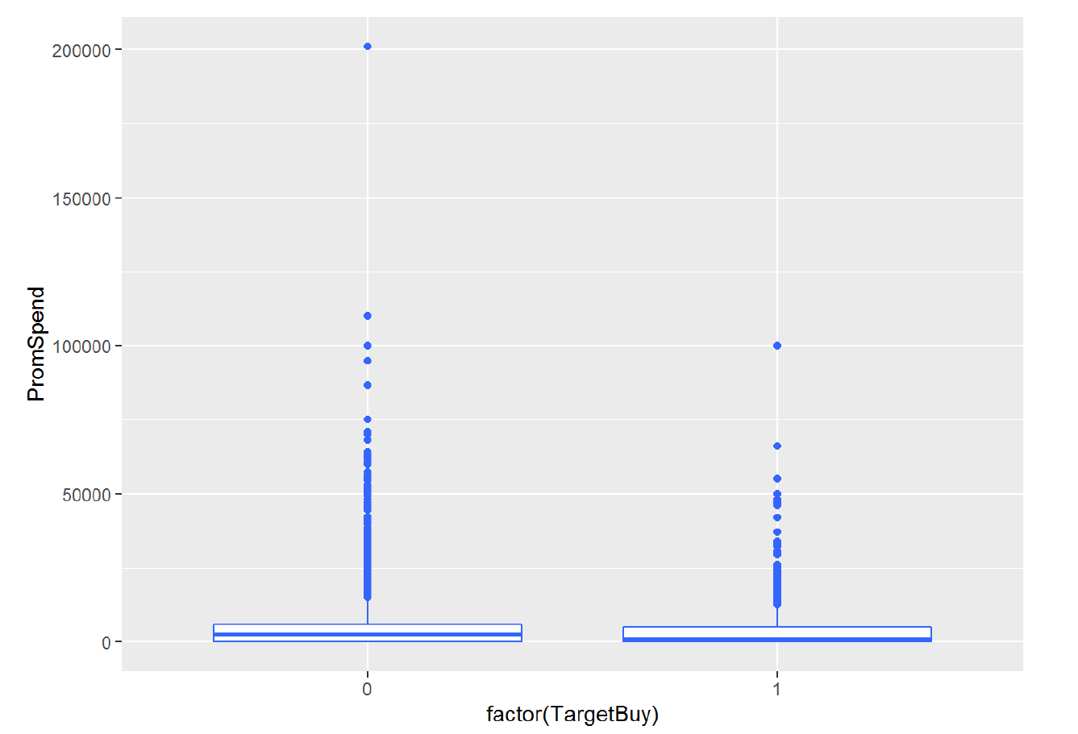
Boxplot PromSpend and TargetBuy

Slide 62
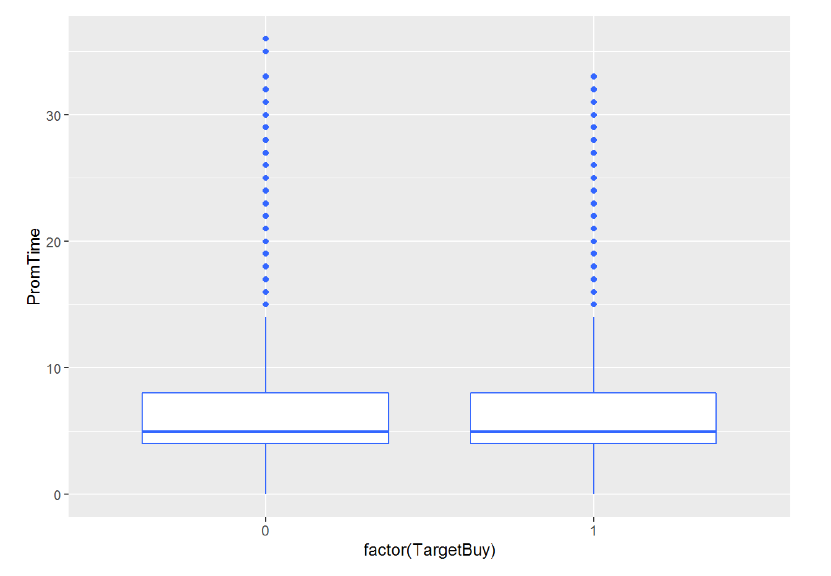
PromTime

Slide 63
Categorical Data Analysis
Proportion
Bar chart
Chi square for independence
Mosaic Plots

Slide 64
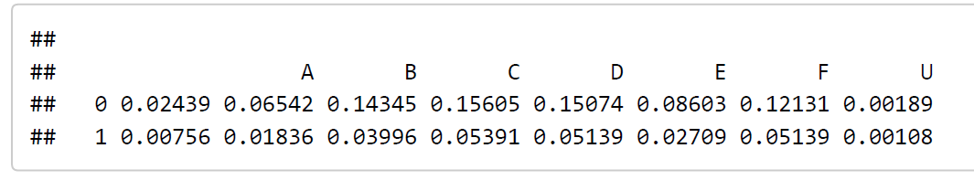
Proportion Of TagetBuy and DemClusterGroup

Slide 65
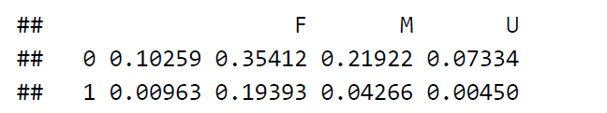
DemGender Proportion

Slide 66
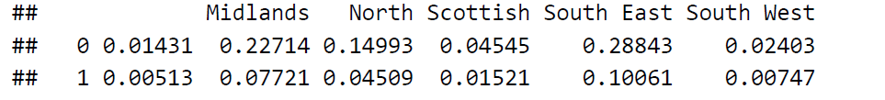
DemReg

Slide 67
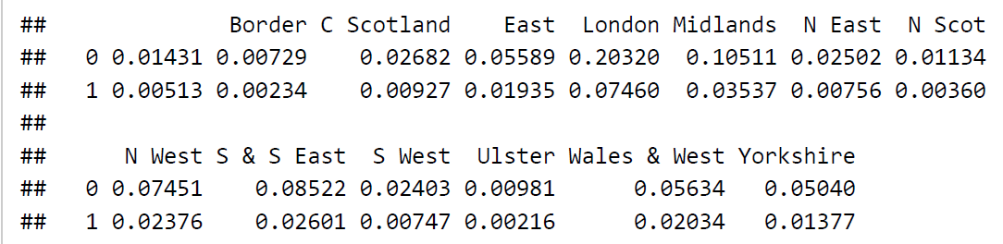
DemTVReg

Slide 68
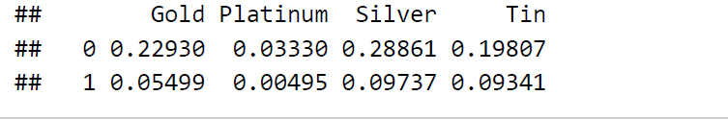
PromClass

Slide 69
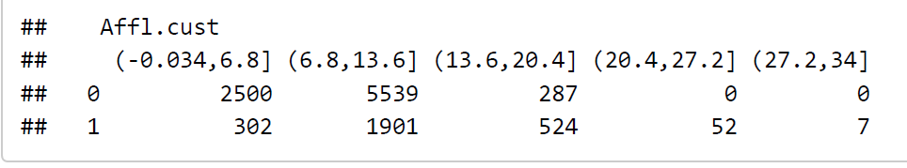
DemAffl:- cut into 5 bins

Slide 70
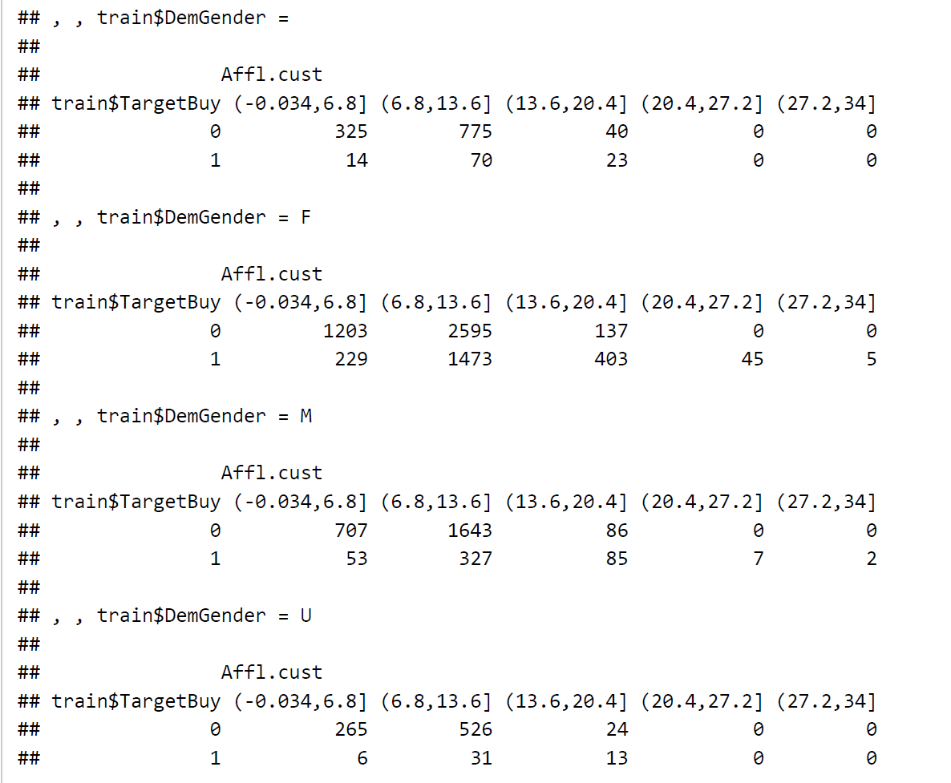
TargetBuy~Gender+Affl

Slide 71
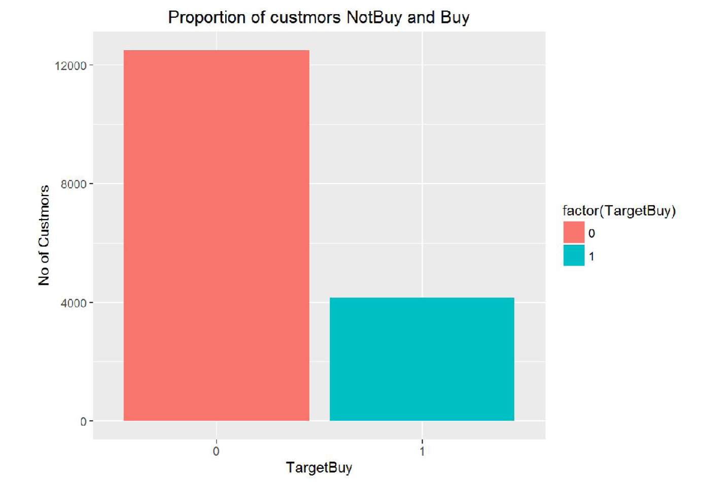
BarPlots

Slide 72
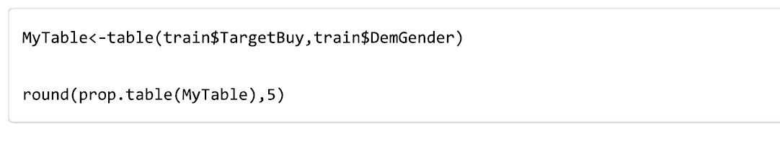
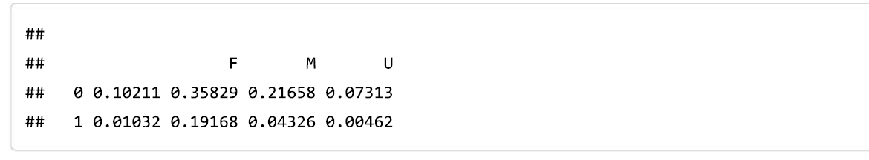
Who tend to Buy More

Slide 73
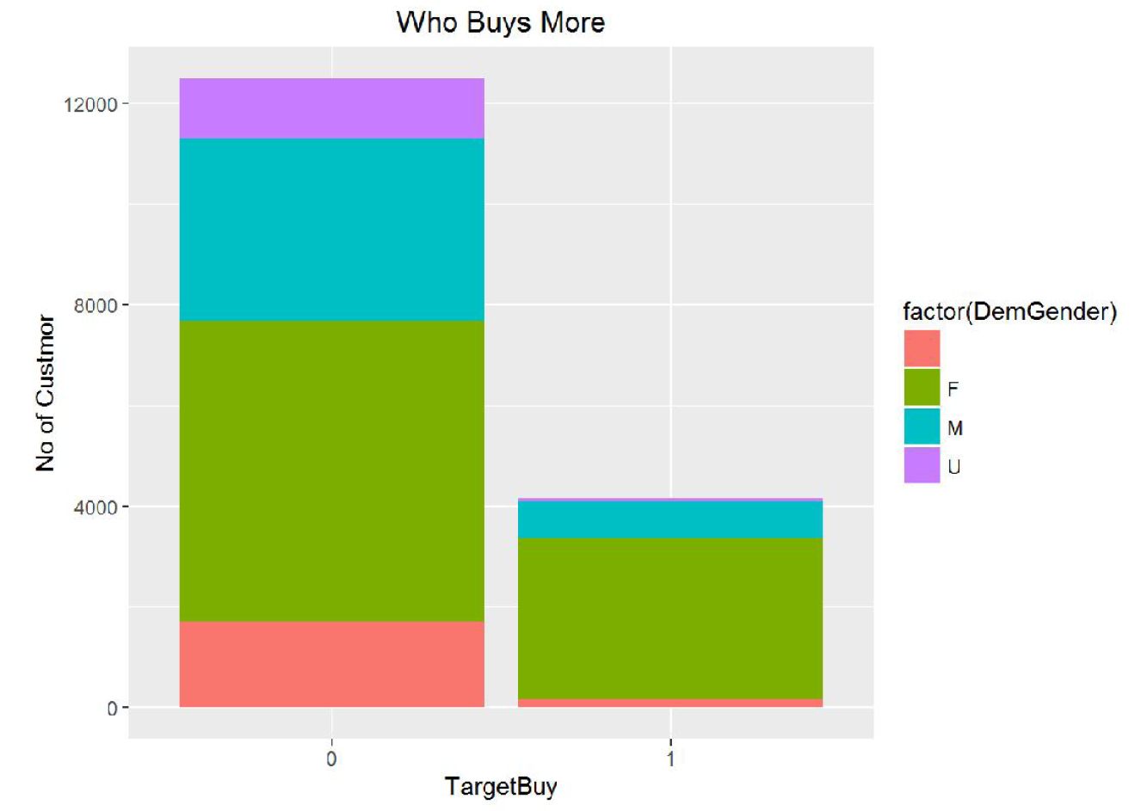

Females Tend To Buy More

Slide 74
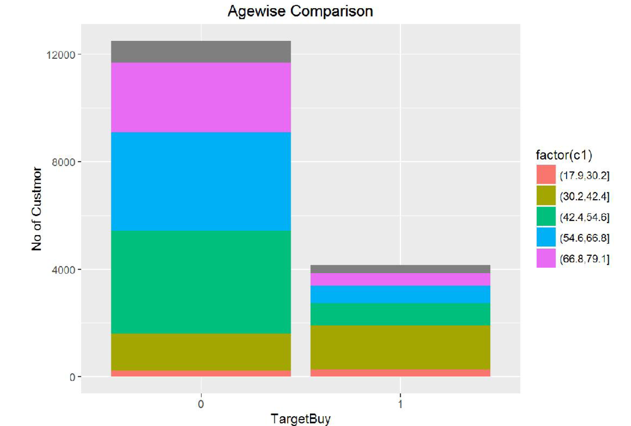

People around 30-42 tend to Buy More

Slide 75
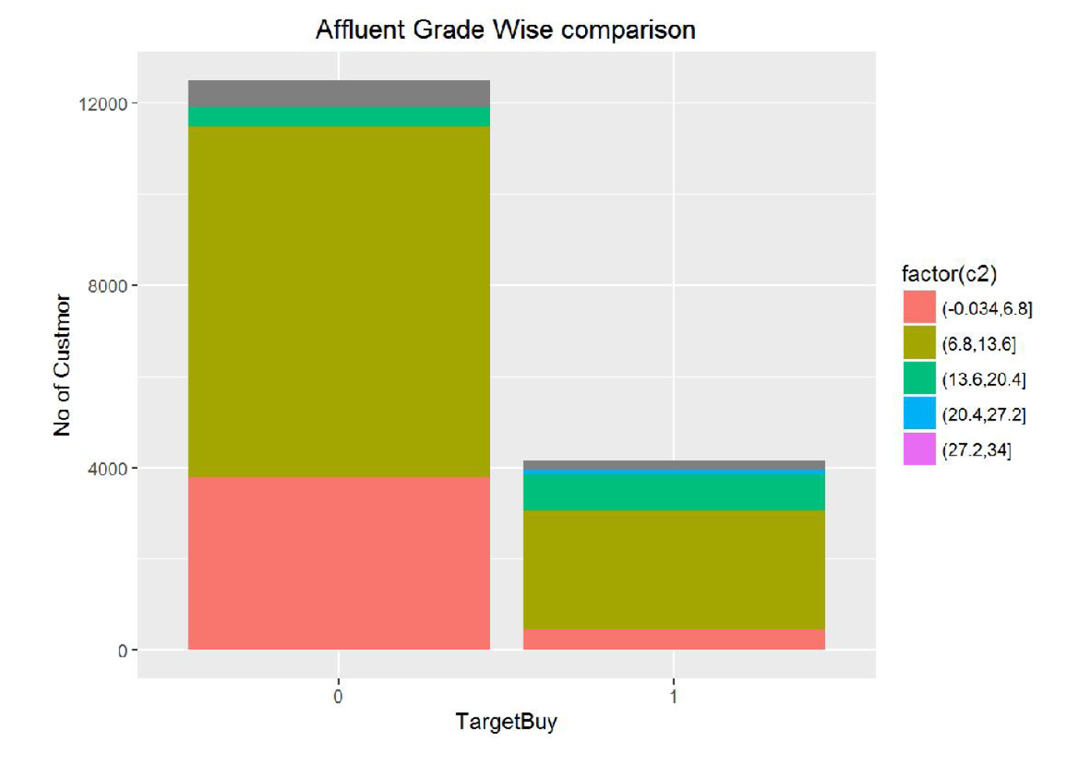
Affluent Grade 6-13 tend to buy more

Slide 76
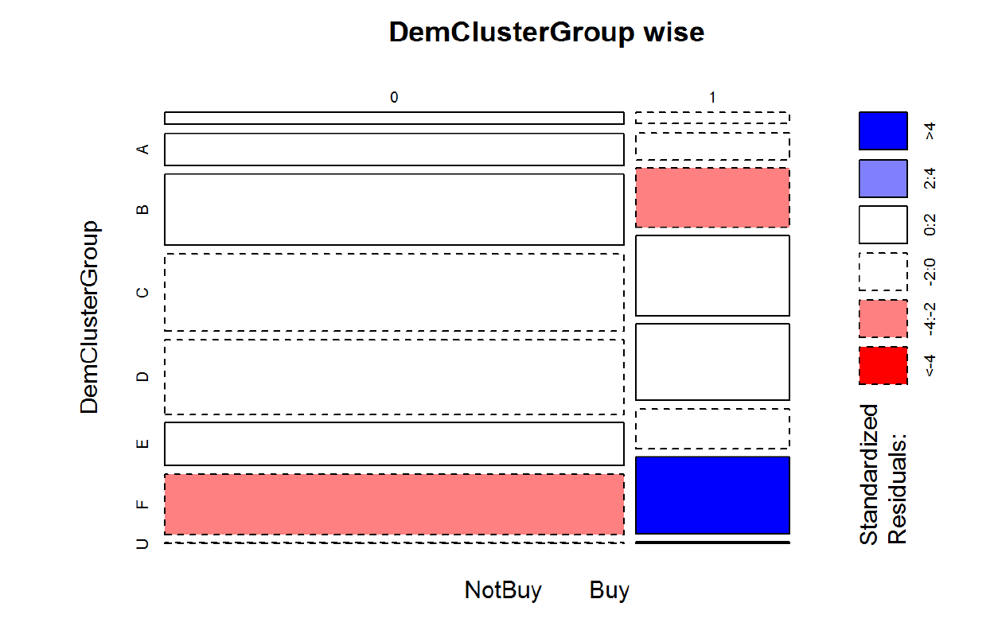
Proportion Buyers Non Buyers

Slide 77
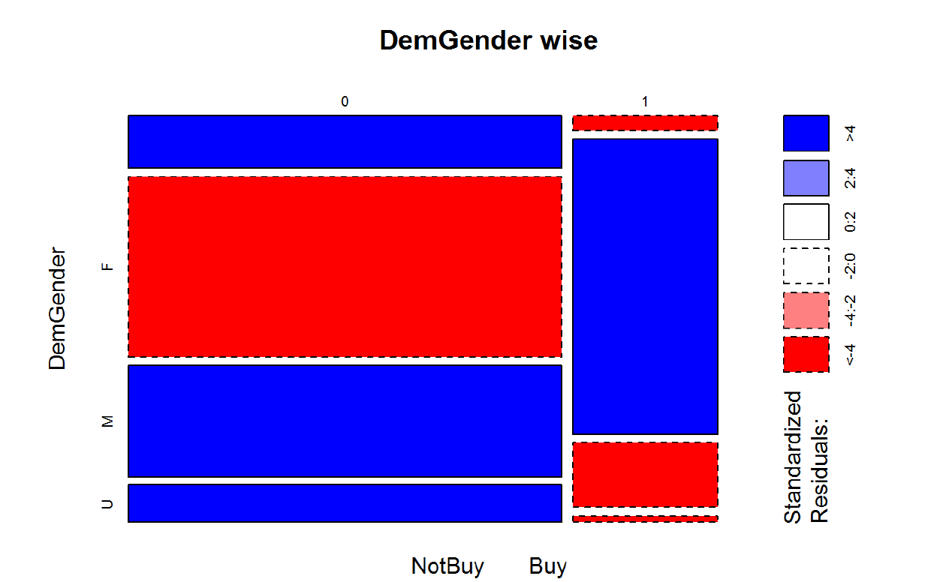
Proportion Buyers Non Buyers

Slide 78
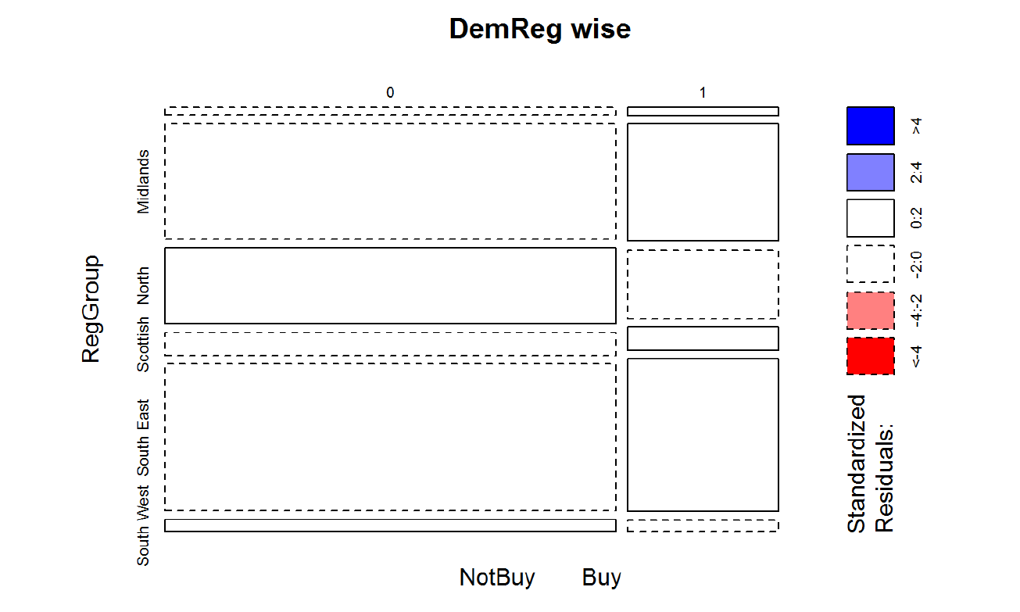
Proportion Buyers Non Buyers

Slide 79
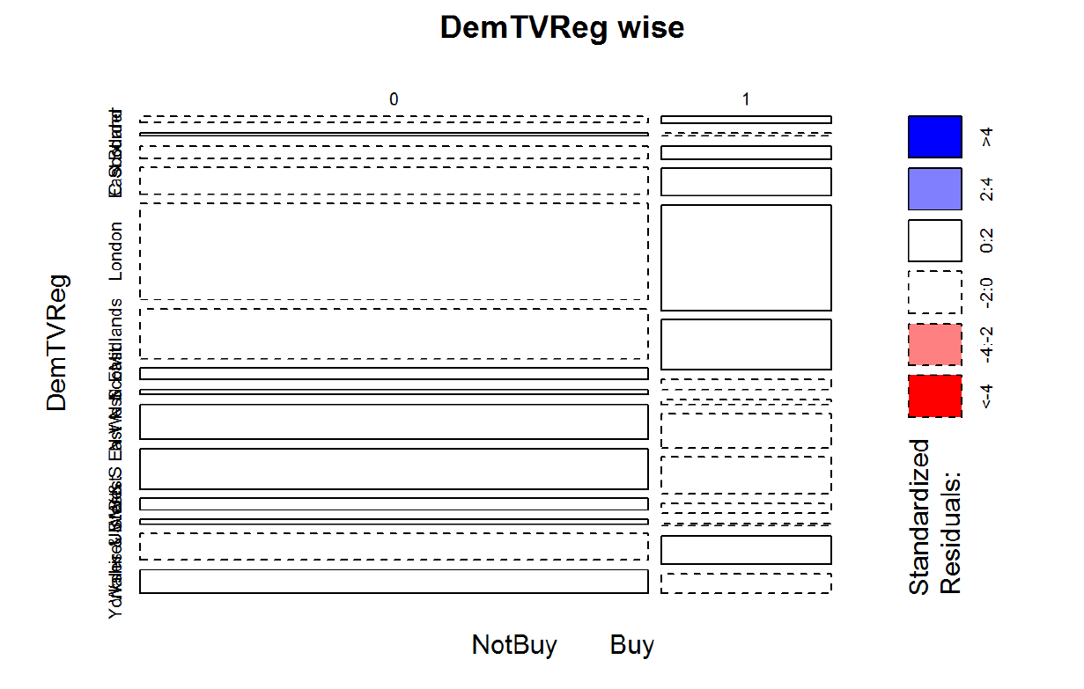
Proportion of Buyers and Non Buyers

Slide 80
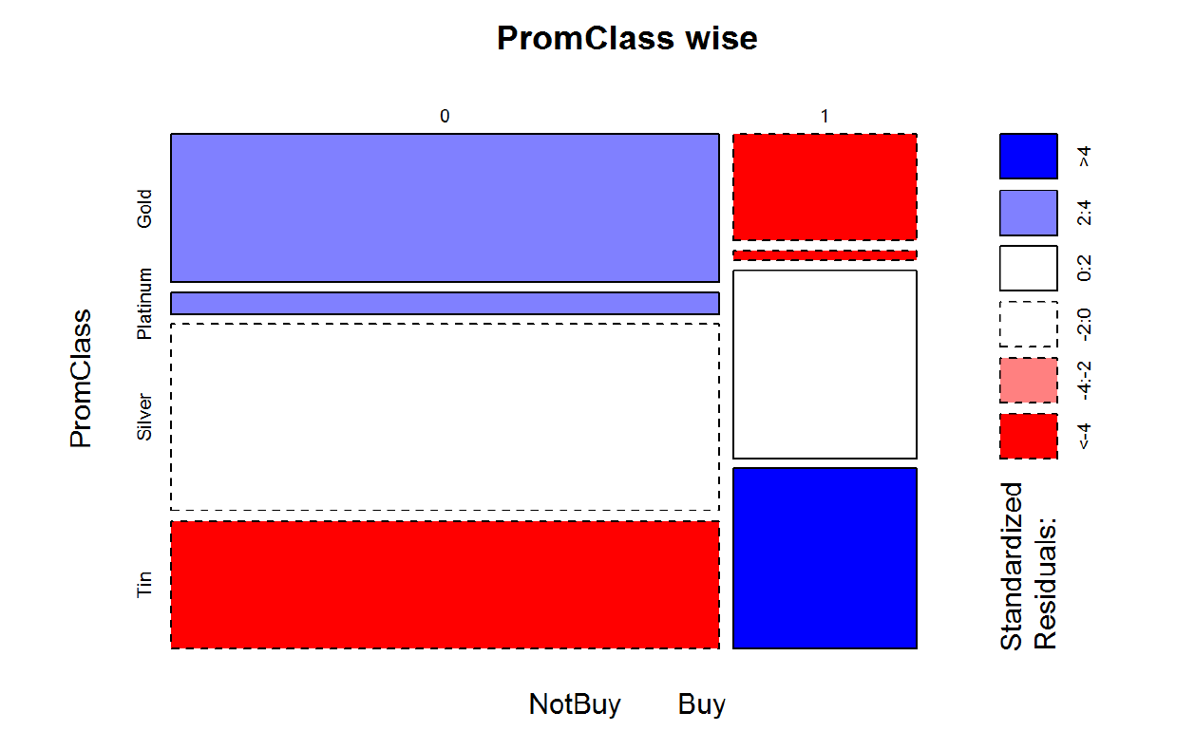
Proportion of Buyers and Non Buyers

Slide 81
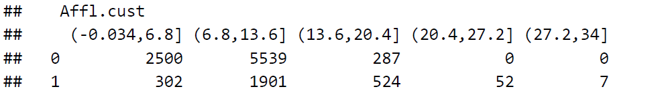
Proportion of Buyers and NonBuyers

Slide 82
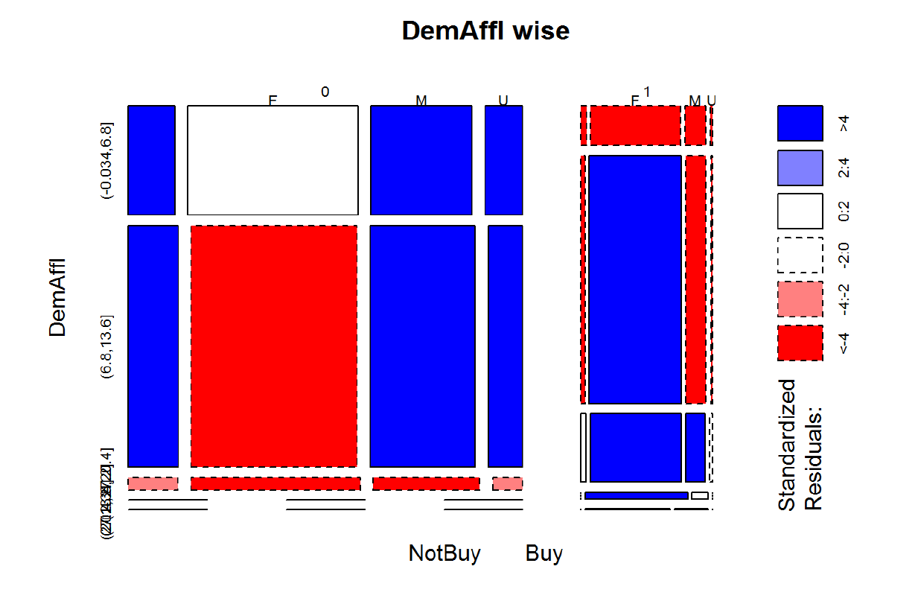
Proportion of Buyers Non Buyers

Slide 83
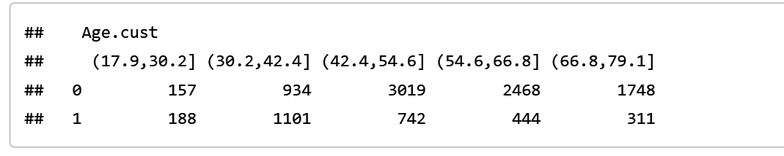
DemAge
High Rate

Slide 84
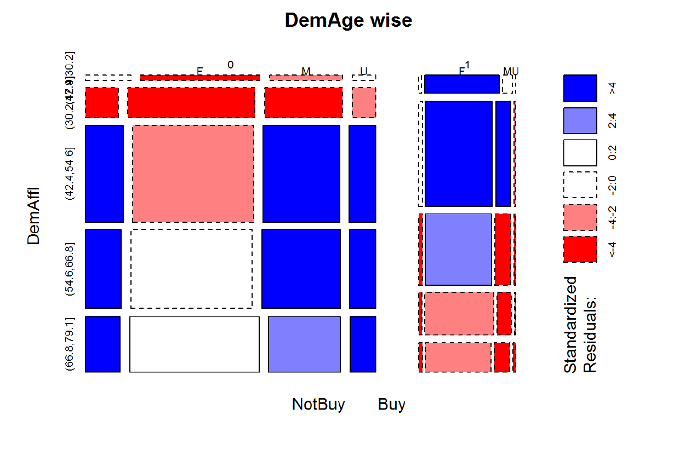
Proportion of Buyer and NonBuyers

Slide 85

Mosiac Plot of Gender, Age and TargetBuy

Slide 86

Gender Affluent Grade and TargetBuy

Slide 87
Whom Should we focus on!!!
Based on the Box plots, Mosaic, and frequency table, we should be able to infer that there is very
little difference in the profitability of customers who buy organic products and those that don’t.
In particular, it does not appear that the high value customers are the ones who are more inclined to buy
organic products.
Further, it’s the customers in the lower levels of the loyalty program (silver and tin) who seem to have been influenced by the coupon to purchase organic products.
This phenomenon could be due to their preference for organic products

Slide 88
Target Them
Middle Age
Female
High Affluent Grade

Slide 89
Boruta
Firstly, it adds randomness to the given data set by creating shuffled copies of all features (which are called shadow features).
Then, it trains a random forest classifier on the extended data set and applies a feature importance measure (the default is Mean Decrease Accuracy) to evaluate the importance of each feature where higher means more important.
At every iteration, it checks whether a real feature has a higher importance than the best of its shadow features (i.e. whether the feature has a higher Z score than the maximum Z score of its shadow features) and constantly removes features which are deemed highly unimportant.
Finally, the algorithm stops either when all features gets confirmed or rejected or it reaches a specified limit of random forest runs.

Slide 90

OutPut Boruta

Slide 91

Results of Boruta

Slide 92


Logistic Regression OutPut

Slide 93

Logit output
AIC (Akaike Information Criteria) – The analogous analogous of adjusted R² in logistic regression is AIC. AIC is the measure of fit which penalizes model for the number of model coefficients. Therefore, we always prefer model with minimum AIC value.
Null Deviance and Residual Deviance – Null Deviance indicates the response predicted by a model with nothing but an intercept. Lower the value, better the model. Residual deviance indicates the response predicted by a model on adding independent variables. Lower the value, better the model.

Slide 94

Accuracy on Training

Slide 95

Accuracy Testing

Slide 96

ROC

Slide 97
Decision Trees
Decision Tree is one of the most commonly used classifier. It is able to handle both numerical and categorical variables and it is insensitive to data errors or even missing data. Most importantly, it provides human-readable rules.
A good choice of cp for pruning is often the leftmost value for which the mean lies below the
horizontal line.

Slide 98
ID 3 Algorithm
(Iterative Dichotomiser 3) is an algorithm invented by Ross Quinlan
Calculate the entropy of every attribute using the data set
Split the set into subsets using the attribute for which entropy is minimum (or, equivalently, information gain is maximum)
Make a decision tree node containing that attribute
Recurse on subsets using remaining attributes.

Slide 99

Decision Tree Robot

Slide 100

Fancy Plot of Tree Using rattle

Slide 101

Decision Tree Robot

Slide 102

Decision Trees Training Performance

Slide 103

Decision Trees Testing Performance

Slide 104

Roc Curve For Decision Tree

Slide 105

Complexity parameter
It is the amount by which splitting the node improved the relative error

Slide 106
Conclusion
Based on this decision tree, the students should recognize that Age, Affluence Grade, and Gender are the most important factors in determining which customers will purchase organic products. In particular, female customers are more likely to purchase the organic products, regardless of age.
For older customers, those that are more affluent are also more likely to purchase organic products.

Slide 107

Naïve Baye’s Robot
It is a classification technique based on Bayes’ Theorem with an assumption of independence among predictors.
In simple terms, a Naive Bayes classifier assumes that the presence of a particular feature in a class is unrelated to the presence of any other feature.

Slide 108
Pros N Cons
It is easy and fast to predict class of test data set. It also perform well in multi class prediction
When assumption of independence holds, a Naive Bayes classifier performs better compare to other models like logistic regression and you need less training data.
It perform well in case of categorical input variables compared to numerical variable(s). For numerical variable, normal distribution is assumed (bell curve, which is a strong assumption).

Slide 109
Zero Frequency Problem
If categorical variable has a category (in test data set), which was not observed in training data set, then model will assign a 0 (zero) probability and will be unable to make a prediction.
This is often known as “Zero Frequency”. To solve this, we can use the smoothing technique. One of the simplest smoothing techniques is called Laplace estimation.

Slide 110

Naïve Bayes on training set

Slide 111

NB Robot on Testing set

Slide 112

ROC for NB Machine

Slide 113

Support Vector Machine
Goal: To find optimal separating Hyperplane
which maximizes the margin of training
data.
Supervised Learning Algorithm
Classification Algorithm.
Linear
Radial(Kernel)(Not Linearly
Seperable)

Slide 114

SVM (Linear)Test

Slide 115

SVM (Radial) Test Performance

Slide 116

ROC-Linear

Slide 117

ROC-Radial

Slide 118
Random Forest
Random Forest is based on Decision Tree. It can handle large dataset and thousands of input variables without variable deletion. In random forests, there is no need for cross-validation or a separate test set to get an unbiased estimate of the test set error. It gives estimates of what variables are important in the classification

Slide 119
Working of Random Forest Robot
Random forest is like a bootstrapping algorithm with Decision tree (CART) model. Say, we have 1000 observation in the complete population with 10 variables.
Random forest tries to build multiple CART model with different sample and different initial variables.
For instance, it will take a random sample of 100 observation and 5 randomly chosen initial variables to build a CART model. It will repeat the process (say) 10 times and then make a final prediction on each observation.
Final prediction is a function of each prediction. This final prediction can simply be the mean of each prediction.

Slide 120

Running random Forest

Slide 121

RF on Training

Slide 122

RF on Test Set

Slide 123

Mean Decrease

Slide 124
Mean Decrease
The variables with a large mean decrease in accuracy are more important for classification of the data.
The mean decrease in Gini coefficient is a measure of how each variable contributes to the homogeneity of the nodes and leaves in the resulting random forest.
Each time a particular variable is used to split a node, the Gini coefficient for the child nodes are calculated and compared to that of the original node.
The Gini coefficient is a measure of homogeneity from 0 (homogeneous) to 1 (heterogeneous).
The changes in Gini are summed for each variable and normalized at the end of the calculation. Variables that result in nodes with higher purity have a higher decrease in Gini coefficient.

Slide 125

Stability

Slide 126

ROC RF

Slide 127
Performance Measures
True Positive Rate also known as "Sensitivity" or "Recall" :
When it's actually yes, how often does it predict yes?
=TP/actual yes
Precision: When it predicts yes, how
often is it correct?
= TP/predicted yes

Slide 128
Performance Measure
Cohen's Kappa: This is essentially a measure of how well the classifier performed as compared to how well it would have performed simply by chance.
F Score: This is a weighted average of the true positive rate (recall) and precision.
ROC Curve: This is a commonly used graph that summarizes the performance of a classifier over all possible thresholds. It is generated by plotting the True Positive Rate (yaxis) against the False Positive Rate (x-axis) as you vary the threshold for assigning observations to a given class.

Slide 129
Final Results
Model | Precision TP/predicted yes | Recall(TPR) TP/actual yes(Sensitivity) | F Measure 2[Pre*Rec/Pre+Rec] | Kappa | Accuracy | AUC
Logistic Regression | 0.4016 | 0.6795 | 0.5048 | 0.3948 | 0.8072 | 0.7957
Decision Tree | 0.4990 | 0.9105 | 0.6446 | 0.4433 | 0.8098 | 0.7438
Naïve Baye’s | 0.5130 | 0.8862 | 0.6497 | 0.4185 | 0.7949 | 0.763
SVM Linear | 0.3847 | 0.9447 | 0.5467 | 0.3877 | 0.8077 | 0.7939
SVM Radial | 0.3847 | 0.9447 | 0.5467 | 0.3877 | 0.8077 | 0.7939
Random Forest | 0.4111 | 0.9190 | 0.6046 | 0.4111 | 0.807 | 0.7866

Slide 130

Cross Validation

Slide 131

Cross validation GLM

Slide 132
Cross validation NB
usekernel
Accuracy Kappa Accuracy SD Kappa SD
## FALSE 0.7925945 0.4267543 0.01062518 0.02765144
## TRUE 0.8037526 0.4259885 0.01246353 0.03549303

Slide 133

References
No Bayesians in foxholes L. Breiman ; California Univ., Berkeley, CA
Statistical Modelling: The Two Cultures (with comments and a rejoinder by the author) L. Breiman
Super Crunchers: How Anything Can Be Predicted Kindle Edition by Ian Ayres .
To Explain or to Predict? Galit Shmueli
American Journal of statistics

Slide 134
References
http://stackexchange.com/ -Forums
http://datascience.stackexchange.com/
http://www.analyticsvidhya.com:- Blog
Applied Predictive Modeling Authors: Kuhn, Max, Johnson, Kjell
Feature Selection with the Boruta Package Miron B. Kursa University of Warsaw Witold R. Rudnicki University of Warsaw. Journal of Statistical Software September 2010, Volume 36, Issue 11. http://www.jstatsoft.org
1)Ggplot2 Elegant Graphics for Data Analysis Authors: Wickham, Hadley
2)The Grammar of Graphics Authors: Wilkinson, Leland

